Slide 1
Diabetes Prediction
Diabetes prediction using machine learning

Slide 2

Introduction
Diabetes prediction uses patient health measurements to predict whether the outcome is diabetic or non-diabetic.
The project uses the pima diabetes dataset and a support vector machine classifier.

Slide 3
Dataset
Pima Indians diabetes database-768 records.
8 features:pregnancies,glucose,bloodpressure,skin thickness ,insulin,BMI, diabetespedigreefunction,age.
target:0=no diabetes,1=diabetes(34.9%positive).

Slide 4
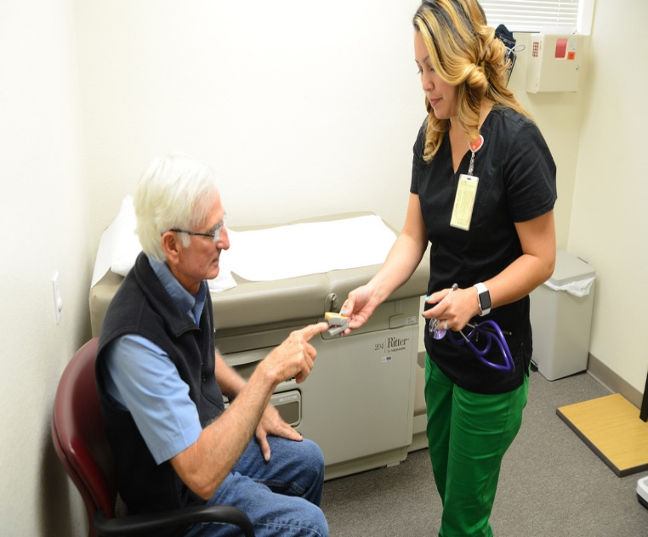
Data preprocessing
Handled zero values as missing(glucose,bp,BMI cannot be 0)
Imputed with median
Feature scaling:standardscaler
Train-test split:80-20,stratified

Slide 5
Models used
Logistic regression-baseline ,interpretable.
Random forest-handles non-linearity.
XGBoost-best performance,regularization .
SVM+Neural network-optional comparison

Slide 6
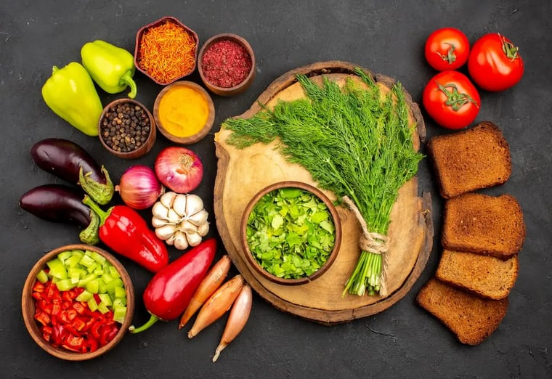
Feature importance
Top 3:glucose(0.32),BMI(0.21),Age(0.18)
Visual:bar chart/shap values
Medical relevance matches domain knowledge

Slide 7
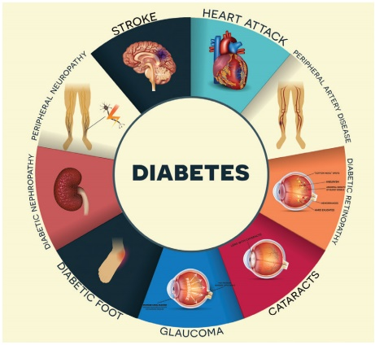
Limitations and future work
Dataset limited to female pima population
Need more diverse data,lifestyle factores
Future:add HbA 1c,integrate with wearable data,real-time monitoring

Slide 8

Conclusion and Q&A
      ML can predict diabetes with-86% accuracy
      Helps in early screening ,not replacement for doctor

Slide 9
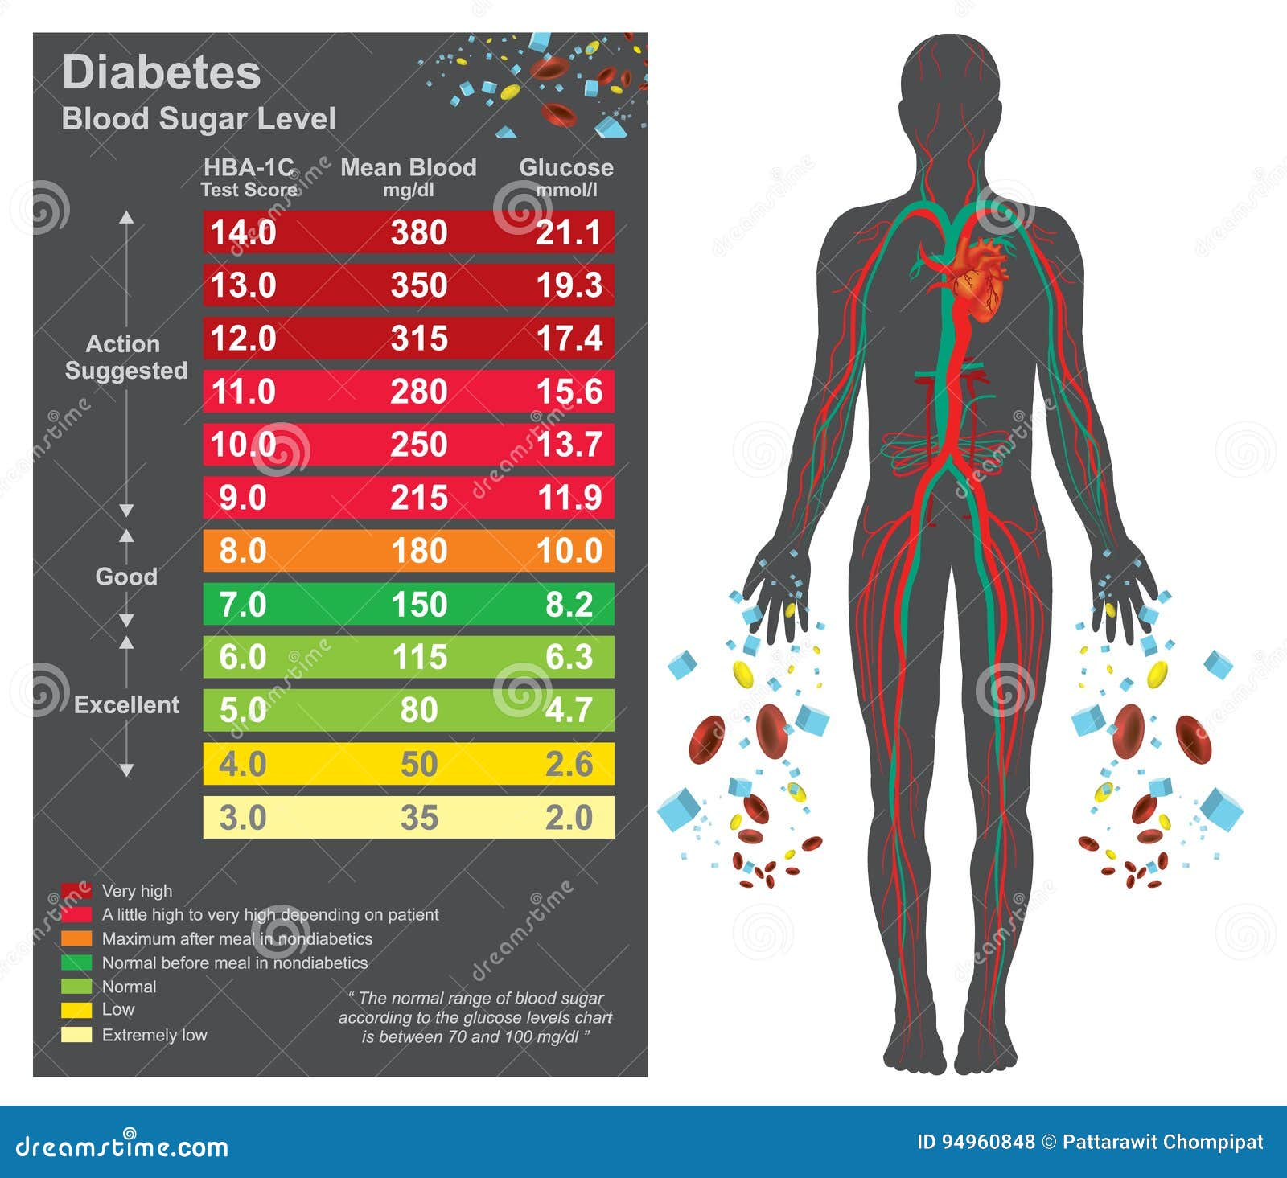
Graph for Diabetic prediction

Slide 10

Thank you

